Slide 1

INTERVIEW STRATEGY DECK
AI Across Protolabs' Production Manufacturing Flow
Business opportunities by stage, the ML and camera capabilities required, a practical implementation path, and the metrics that prove value.
Round 2 · Expanded version with stage-by-stage companion slides for disruption logic, execution, and measurable outcomes.
INTAKE
DECISIONING
MANUFACTURING
TRUST
PROTOLABS TPM-AI · AI STRATEGY ACROSS THE 9-STAGE FLOW

Slide 2
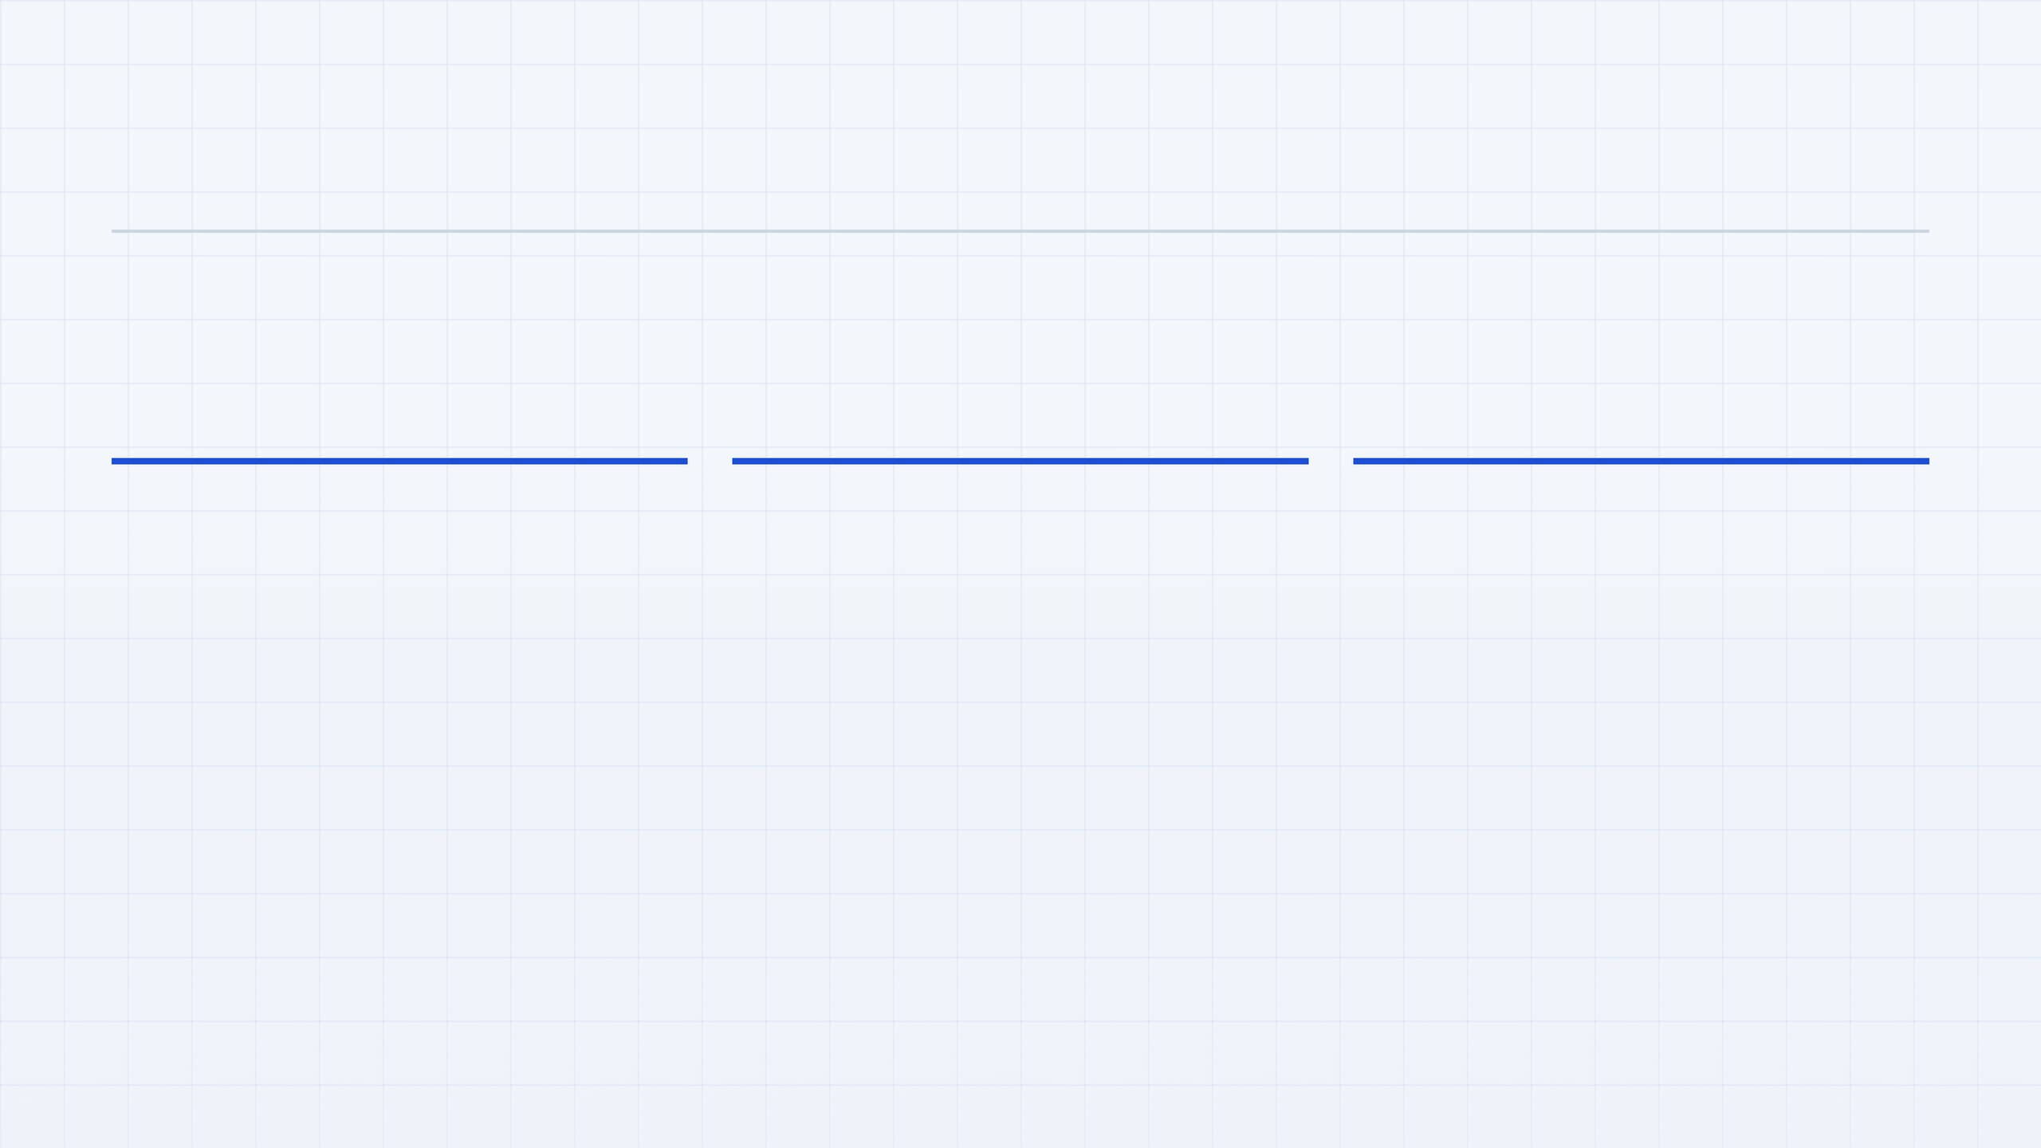
The conversation works best when every stage fits one strategic spine
MASTER FRAME
The point is not to present nine disconnected AI ideas. The point is to show a coherent operating model: use AI to widen the funnel, improve decisions, and build a proprietary learning loop while keeping engineers and quality teams in the loop where trust and regulation require judgment.
01
02
03
Expand revenue and improve unit economics at the same time
Keep engineers in the loop and turn their judgment into data
Sequence delivery so each stage unlocks the next
The strongest bets do both. Multimodal intake opens new no-CAD markets; routing, pricing, and machine intelligence improve margin, lead time, and throughput on the work already won.
AI should absorb repetition, pattern recognition, and drafting. Engineers remain accountable for exceptions, customer trust, and technical judgment. Their overrides become the training signal that improves the next model.
Start with intake and structured data, then add routing and engineer copilot, then push into vision, pricing loops, and machine intelligence. The value compounds only if the substrate is built first.
PROTOLABS TPM-AI
STRATEGIC FRAMING BEFORE STAGE-BY-STAGE ANALYSIS

Slide 3

The current requirement for a CAD file is not only a workflow assumption. It is a market boundary.
STAGE 1 / 9 · CLIENT EDGE
Expand Intake Beyond CAD
TODAY
Many requests start only when the customer already has a usable CAD file or a production-ready spec package. That works for mature buyers, but it excludes demand that begins with photos, sketches, PDFs, or a legacy part on a workbench.
The first commercial decision is whether Protolabs can respond to customer ambiguity faster than competitors can ask for more documentation.
DISRUPTION LOGIC
If Protolabs accepts multiple photos plus partial documentation, it can price and route work that competitors still reject as incomplete. The AI win is not a chatbot; it is a structured extraction layer that converts messy intake into a usable Order Object.
TOP IDEA
Launch multimodal RFQ intake that accepts CAD, sketch, PDF, email, or photos of an existing part. The commercial result is lower friction to yes and a wider funnel before CAD exists.
PROTOLABS TPM-AI
STAGE ANALYSIS WITH DISRUPTION FRAMING

Slide 4

STAGE 1 COMPANION · STRATEGY, STACK, EXECUTION
New Market, Not Just New UX
Accepting multiple photos, sketches, PDFs, and partial specifications does more than improve usability. It allows Protolabs to capture demand from products that do not yet have CAD and to monetize early-stage manufacturing intent that competitors still turn away.
BUSINESS OPPORTUNITY
REQUIRED AI AND CAMERA STACK
IMPLEMENTATION PATH
HOW TO MEASURE
Multimodal intake expands the addressable market
What capabilities are needed to make this real
Start narrow, route uncertainty to engineers
Track growth and proof of fit
Non-CAD RFQ conversion How often incomplete submissions become viable quotes or orders.
Today, the process assumes the customer already has a usable CAD file. That excludes spare-parts replacement, MRO requests, legacy-part recreation, field-service teams, and smaller buyers who only have photos or drawings.
ML/AI: multimodal document understanding, OCR, image-to-geometry reasoning, feature extraction, confidence scoring, and LLM-based conversion into a canonical Order Object.
Pilot on simple part families where manual quoting is repetitive and dimensions are visually recoverable. Build a triage layer so high-confidence jobs flow forward while low-confidence jobs are reviewed by application engineers.
Time to first quote Whether the intake layer actually reduces friction and cycle time.
If Protolabs can reconstruct enough structured information from multiple photos plus partial documentation, it can quote work others reject as incomplete and create a paid pre-CAD service layer.
Camera workflow: guided capture for the right angles, scale references, lighting checks, and image-quality validation before submission.
Engineer touches per RFQ Whether extraction quality is reducing manual effort.
Store every correction, accepted field, and rejected extraction so the intake system improves with each quote rather than remaining a static feature.
Revenue from new no-CAD segments Whether the funnel is truly expanding into new markets.
PROTOLABS TPM-AI
STAGE 1 COMPANION · BUSINESS OPPORTUNITY, STACK, IMPLEMENTATION, METRICS

Slide 5

Make Engineers Faster and More Valuable
STAGE 2 / 9 · INTERNAL OPS
The fastest visible AI win is not replacing engineers. It is giving them a copilot that removes repetitive drafting, speeds customer response, and preserves their authority on the decisions customers actually trust.
The goal is higher-value engineer time, not fewer engineers.
TODAY
Engineers translate customer requests into manufacturable guidance, process recommendations, and quote-ready responses. Much of that work is valuable, but a large share is also repetitive and time-sensitive.
STRATEGIC LENS
An engineer copilot should be framed as a capacity multiplier. Faster, better-drafted responses improve trust and conversion, while every engineer correction becomes proprietary feedback data for the next recommendation.
Applications engineers are the trust layer between customer ambiguity and manufacturable reality. If AI gives them hours back each week, they can spend that time on judgment, exceptions, and consultative selling instead of repetitive drafting.
TOP POINT
Start with AI-drafted replies, manufacturability summaries, and suggested next actions grounded in internal knowledge. Engineers keep the final word, and that is exactly why the system will be adopted rather than resisted.
PROTOLABS TPM-AI
STAGE ANALYSIS WITH TRUST AND THROUGHPUT FRAMING

Slide 6

Expertise turns into a reusable learning asset when every engineer interaction is captured, ranked, and improved
STAGE 2 COMPANION
Engineer time becomes revenue capacity
AI SKILLS / TOOLS
IMPLEMENTATION
Use retrieval-augmented generation, semantic search, and next-best-action ranking. Capture structured feedback from edits and approvals so accepted changes improve future drafts.
Start narrow: email drafting and manufacturability explanations with engineers as approvers. Log edits and expand features after trust is earned.
A strong copilot raises response speed and conversion while converting expert judgment into proprietary operating data. Let AI draft the repeatable 80% and keep engineers as final approvers for manufacturability and trade-offs.
MEASURE
Track response time, adoption, edit distance, quote conversion, and upsell rate to show the copilot increases commercial throughput.
PROTOLABS TPM-AI
BUSINESS VALUE + AI CAPABILITY STACK + IMPLEMENTATION PATH

Slide 7

Route with learning, not only rules, and the network turns into a moat
STAGE 3 / 9 · MANUFACTURING
This is the most defensible AI opportunity in the flow because the asset is not just the model. It is Protolabs' history of routing decisions, partner performance, quality outcomes, lead times, and manufacturing fit across the network.
Why this deserves strategic-bet budget
TODAY
MOAT LOGIC
The order is matched to an in-house factory or manufacturing partner using rules, experience, and static capability logic. That works, but it leaves learning trapped inside people and spreadsheets instead of compounding inside the system.
A routing model can learn from quality history, on-time delivery, scrap, cost variance, geography, certifications, and capacity fit. The more jobs it sees, the harder it becomes for another network to match its decision quality.
Competitors can buy models, but they cannot easily recreate Protolabs' years of outcome data across factories and suppliers. Each routed job makes the next decision better.
TOP IDEA
Start with ML-assisted factory and partner ranking beside the current process. Let humans override. Capture outcomes and overrides, then automate bounded job classes where confidence and economics are clear.
PROTOLABS TPM-AI
ROUTING INTELLIGENCE AS COMPOUNDING NETWORK ADVANTAGE

Slide 8

STAGE 3 COMPANION
Routing becomes a moat when allocation learns from outcomes competitors cannot see
STAGE 3 / 9 · MANUFACTURING
The strategic value is not merely better matching. It is the creation of a proprietary decision engine that learns which factory or partner is best for each part geometry, tolerance profile, geography, and service requirement.
ML CAPABILITIES
IMPLEMENTATION PATH
MEASURES OF VALUE
What the model stack needs to do
How to deploy without operational risk
What proves the moat is real
Use ranking models to recommend best-fit sites or suppliers and feed them with partner performance embeddings from quality history, lead-time adherence, capacity, certifications, geography, and cost variance. Add capacity forecasting and constraint-aware optimization so routing reflects reality when work lands.
Start as a side-by-side recommender that explains top choices and signals. Standardize training on part type, material, tolerances, outcomes, delivery, scrap, and certifications; automate bounded job classes first and expand as confidence grows.
The best evidence is operational and commercial improvement that compounds with every routed order.
Margin
Gross margin vs historical baseline.
Delivery
On-time performance and lead-time reliability.
Quality
Scrap, rework, and certification fit after routing.
Trust
Manual override rate and recommendation acceptance.
PROTOLABS TPM-AI
NETWORK DATA + LEARNING LOOP = DEFENSIBLE ROUTING ADVANTAGE

Slide 9

The goal is not opaque dynamic pricing. The goal is confidence-aware pricing that improves with every quote outcome.
STAGE 4 / 9 · PRICING & QUOTE
Turn Pricing Into a Closed Learning Loop
TODAY
Quotes are generated using rules, expert judgment, and static assumptions about cost, lead time, and customer willingness to buy. Valuable signals exist, but much of the learning from wins, losses, and quote-to-actual variance is not systematically reused.
Pricing is where revenue, margin, and trust meet. The strategic opportunity is to make every quote both a commercial decision today and a learning input for a better decision tomorrow.
DISRUPTION LOGIC
A pricing system should learn from conversion, margin, delivery outcomes, and customer trade-offs. That turns pricing into a compounding commercial engine rather than a one-time decision made in isolation.
TOP IDEA
Start with confidence-scored recommendations inside clear policy guardrails. Let humans override when needed. Then feed quote results back into the model so pricing gets sharper without becoming unfair, unpredictable, or hard to explain.
PROTOLABS TPM-AI
STAGE ANALYSIS WITH PRICING AS A LEARNING SYSTEM

Slide 10

STAGE 4 COMPANION · STRATEGY, STACK, CONTROL
Adaptive Pricing Is a Product
The pricing engine should do more than set a number. It should help Protolabs monetize speed, certainty, and manufacturing fit while learning from every quote outcome inside clearly defined commercial boundaries.
BUSINESS UPSIDE
REQUIRED AI / ML STACK
IMPLEMENTATION GUARDRAILS
SUCCESS METRICS
Pricing becomes a commercial lever, not only a quote calculation
What capabilities make adaptive pricing credible
Roll out safely and keep commercial trust intact
Measure learning and commercial performance
Core models: conversion prediction, elasticity estimation, anomaly detection, and confidence scoring so the system knows when to recommend, when to escalate, and when not to act.
Launch in shadow mode first so recommendations can be compared with current quoting behavior before prices change in production. Keep manual override paths and explicit policy caps on discounts, margins, and customer consistency.
Margin lift Incremental gross margin versus baseline quoting logic.
Better pricing can lift margin, reduce quote latency, and create differentiated offers such as price-versus-lead-time trade-offs, quote-speed tiers, and design-for-cost recommendations.
Quote acceptance Whether improved pricing also protects conversion.
Decision layer: reason-code generation, fairness and policy checks, and closed-loop learning from wins, losses, quote-to-actual variance, and override behavior.
Quote-to-actual variance How closely expected economics match real outcomes.
The strategic value is cumulative: each order improves the next commercial decision instead of leaving pricing knowledge trapped in manual heuristics.
Only expose customer-facing optimization options after internal confidence is strong and the organization can explain why the system recommended a given range.
Override frequency Whether trust in recommendations is increasing over time.
PROTOLABS TPM-AI
STAGE 4 COMPANION · ADAPTIVE PRICING BUSINESS LOGIC, CAPABILITIES, GUARDRAILS, METRICS

Slide 11

STAGE 5 / 9 · MANUFACTURING
Samples Are a Commercial Trust Gate
Sample parts are not just a manufacturing checkpoint. They are the moment when a customer decides whether Protolabs feels reliable enough for the larger production order that follows.
STRATEGIC LENS
DISRUPTION LOGIC
RECOMMENDED MOVE
First-pass sample success is close-rate leverage
AI can improve the part before the commercial decision is made
1 · PREDICT
Model yield and likely defect risk before the sample run begins.
Large production business is often won or lost quietly at the sample stage. A failed first article, a delayed revision cycle, or a vague inspection result weakens confidence right before the customer is ready to scale the program.
2 · INSPECT
Use historical run data, process knowledge, and dimensional inspection signals to predict where a part is likely to fail and to recommend better process settings before the sample is built. The strategic goal is higher first-pass approval, because faster technical confidence translates into faster commercial commitment.
Use vision-assisted dimensional checks and clearer first-article evidence.
3 · CONVERT
Turn faster sample approval into a shorter path from validation to production PO.
PROTOLABS TPM-AI
STAGE ANALYSIS WITH SAMPLE-TO-PRODUCTION CONVERSION FRAMING

Slide 12

STAGE 5 COMPANION · PREDICTIVE YIELD + VISION
First-pass success wins bigger programs
Sample approval is not only a technical checkpoint. It is the trust gate between a promising quote and a production-scale commitment. If Protolabs improves first-pass sample success, it increases the probability that larger-volume work converts faster and with less hidden deal friction.
BUSINESS SIGNIFICANCE
AI / VISION CAPABILITIES
IMPLEMENTATION + MEASURE
Samples shape commercial conversion, not just QA
What the model and camera stack must do
Start with one process family and prove the loop
Predictive yield models should estimate whether a part is likely to pass on first run by learning from process parameters, geometry class, materials, tolerance windows, and historical run outcomes.
Begin on a process family with enough run history and clear pass/fail criteria. Keep engineers reviewing model outputs and use vision first as measurement assistance rather than full autonomy.
Failed first articles often kill larger contracts quietly. Customers may not escalate the reason, but confidence drops when sample runs miss dimensional targets, surface finish, or approval timing.
Required skills: process-window modeling, supervised prediction, anomaly detection, image calibration, dimensional measurement workflows, and human-reviewed reporting.
KPIs: first-pass sample approval, time from sample to production PO, sample scrap cost, approval-cycle length, and conversion from sample order to larger production award.
PROTOLABS TPM-AI
STAGE 5 COMPANION · PREDICTIVE YIELD, VISION, IMPLEMENTATION, AND METRICS

Slide 13
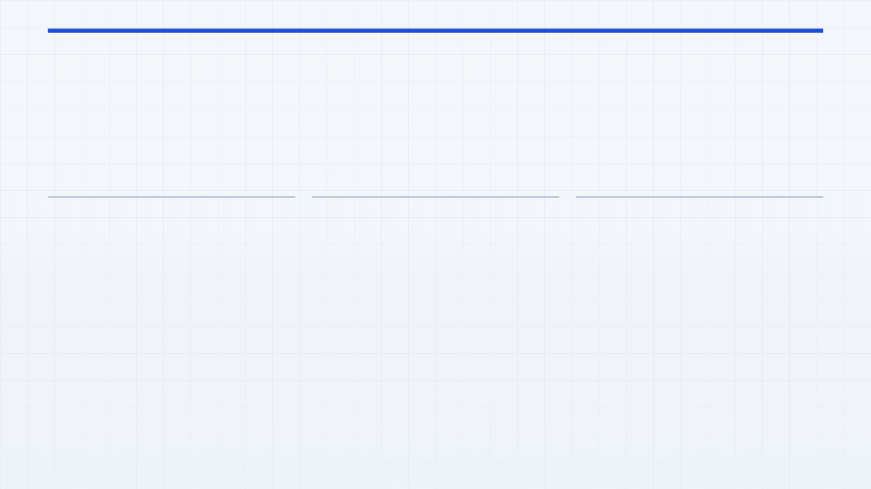
STAGE 6 / 9 · MANUFACTURING
Put AI on the Machine Layer
Many AI roadmaps stop at office workflows and dashboards. The deeper operational prize is on the factory floor, where machine telemetry, predictive models, and better scheduling create recurring cents-per-part savings through higher uptime, tighter process control, and more output per machine hour.
UPTIME
PROCESS CONTROL
SCHEDULING
Predict failure before it stops production
Stability beats flashy autonomy at the start
Machine intelligence includes orchestration
Machine data should not only explain downtime after the fact. It should identify drift, tool wear, and failure risk early enough to prevent lost hours, emergency maintenance, and missed delivery commitments.
Do not begin with reinforcement learning. Begin with sensor quality, SPC, anomaly detection, and recommendation-driven parameter tuning. That is how control systems earn trust on the floor.
Factory performance depends on what runs, where, and when. Better scheduling can reduce bottlenecks, smooth utilization, and improve throughput without adding equipment.
PROTOLABS TPM-AI
FACTORY-FLOOR AI AS RECURRING MARGIN CREATION

Slide 14

STAGE 6 COMPANION · OPERATIONAL AI STACK
Machine Intelligence Compounds Margin
The strategic value of factory-floor AI is not novelty. It is recurring economic improvement through better uptime, tighter process stability, and smarter scheduling across constrained assets.
BUSINESS LOGIC
REQUIRED AI / ML STACK
ROLLOUT APPROACH
KPIS
Margin gains happen on the machine, not in the slideware
What capabilities are needed on the floor
Phase implementation to earn trust
Measure recurring operational value
Core capabilities: sensor and telemetry integration, time-series anomaly detection, predictive maintenance models, process-drift detection, and scheduling optimization across machines or cells.
Start by instrumenting clean machine data and building SPC visibility. Then deploy predictive alerts for wear, drift, and failure risk. Only after the signal quality is trusted should the system recommend parameter changes or tighter scheduling moves.
OEE Whether machine availability and performance improve together.
Software-only AI programs often stop before they touch the real economics of manufacturing. The deeper opportunity is to reduce downtime, scrap, and cycle variability where each small improvement repeats across every production run.
Scrap rate Whether process stability reduces wasted material and rework.
Advanced layer: recommendation-driven parameter tuning first, then bounded adaptive control only where telemetry is reliable, rollback is safe, and process physics are stable.
Downtime Whether alerts prevent costly interruptions.
That is why machine intelligence matters: it turns operational learning into recurring cents-per-part savings.
Autonomy should be a late-stage option, not the starting pitch.
Throughput Whether output per machine-hour increases sustainably.
PROTOLABS TPM-AI
STAGE 6 COMPANION · MACHINE AI STACK, ROLLOUT, AND KPIS

Slide 15

Inspection AI should lower cost, increase consistency, and create a traceable quality record that customers and auditors can trust.
STAGE 7 / 9 · MANUFACTURING
Vision QA Creates Both Savings and Trust
TODAY
Quality is confirmed by human inspection and process checks, which protects standards but creates shift-to-shift variability and slower defect feedback.
STRATEGIC LENS
Vision systems improve throughput, scrap detection, and repeatability while producing digital records that simplify audits and ROI justification.
Quality control is a clear early AI wedge: it reduces defects and preserves human oversight to keep trust intact.
TOP POINT
Deploy where scrap or manual load is highest. Use vision as assistive triage with human confirmation, and use defect history to refine models and audit trails.
PROTOLABS TPM-AI
STAGE ANALYSIS WITH ROI AND COMPLIANCE FRAMING

Slide 16

STAGE 7 / 9 · MANUFACTURING
STAGE 7 COMPANION · VISION QA OPERATING STACK
Cameras need more than a model
AI-assisted QA works when capture is engineered alongside the model: controlled cameras, human review, traceability, and monitoring combine to form a reliable system.
CAMERA STACK
VISION MODELS + WORKFLOW
IMPLEMENTATION + METRICS
Inspection quality starts at the station, not in the algorithm
Deploy as assistive triage before autonomy
Start where scrap is worst and proof is fastest
Industrial cameras, fixed optics, controlled lighting, calibration routines, and repeatable part positioning keep the image stream stable so inspections remain reliable.
Defect detection, anomaly grading, and traceability outputs should be paired with humans confirming borderline decisions so models learn from corrections.
Choose the inspection point with the highest scrap cost, standardize capture, and launch vision as a triage layer.
Human-in-the-loop workflows prioritize and label the right examples for retraining.
False negatives Escaped defects that damage customers and confidence.
Scrap reduction Whether inspection lowers waste.
For some workflows, guided multi-angle capture reveals defects a single view misses.
Required ML skills: supervised training, anomaly detection, drift monitoring, and labeling ops.
Required skills: camera selection, lighting design, calibration, and station engineering with manufacturing teams.
Inspection labor Whether teams spend less time on repetitive checks.
Escapes & audits Traceability and compliance readiness.
PROTOLABS TPM-AI
STAGE 7 COMPANION · CAMERA STACK, MODEL WORKFLOW, IMPLEMENTATION, METRICS

Slide 17

Warehousing Can Become Predictive Revenue
STAGE 8 / 9 · CLIENT EDGE
Stored inventory should not be treated as a passive fulfillment option. With demand forecasting and reorder prediction, warehousing becomes a retention engine, expansion lever, and service advantage built on customer history that Protolabs already owns.
STRATEGIC REFRAME
TODAY
DISRUPTION LOGIC
Every repeat customer is a demand signal, not just a stored order
Warehousing is largely passive: parts wait in storage until the customer decides to request more or release inventory.
Order history and consumption patterns can power reorder prediction, turning warehousing into a proactive service that helps avoid stockouts and capture future demand.
The real opportunity is growth from existing customers at near-zero acquisition cost by predicting when they will need the next batch and making reorder timing easier and more useful.
TOP IDEA
QUICK WIN
Offer an opt-in reorder intelligence service: forecast replenishment windows, link signals to batch releases, and present it as planning support.
Start with high-frequency repeat buyers where patterns are strongest to validate forecasting and ROI.
PROTOLABS TPM-AI
STAGE ANALYSIS WITH RETENTION AND EXPANSION FRAMING

Slide 18

STAGE 8 COMPANION · PREDICTIVE WAREHOUSING
Forecasting Makes Inventory Commercial
Warehousing becomes strategically valuable when stored parts are treated not as passive inventory, but as a predictive revenue opportunity. The goal is to use reorder signals to increase retention, improve service levels, and make existing customer demand more visible before the next order is requested.
BUSINESS LOGIC
REQUIRED AI / ML STACK
ROLLOUT + METRICS
Inventory can act like a commercial signal, not only a storage cost
What the forecasting system needs to do
Start narrow, prove service value, then expand
Core capabilities: demand forecasting, reorder propensity models, customer segmentation, inventory optimization, and recommendation systems for replenishment timing or warehouse placement.
Launch with repeat customers and an opt-in replenishment service. Use forecasts first to inform internal release and placement decisions, then add customer-facing recommendations once prediction quality and messaging are trusted.
Repeat customers already generate demand patterns through order frequency, part families, and replenishment timing. If Protolabs can forecast these patterns well, warehousing shifts from a passive service into a low-acquisition-cost growth lever.
Required skills: time-series modeling, supervised propensity prediction, inventory analytics, segmentation logic, and decision design that keeps the experience helpful rather than intrusive.
Reorder rate — Whether forecasting increases repeat purchase capture; Expansion revenue — Whether predictive warehousing creates incremental sales from existing accounts; Forecast accuracy — Whether the demand model is reliable enough to influence decisions.
PROTOLABS TPM-AI
STAGE 8 COMPANION · BUSINESS LOGIC, AI STACK, ROLLOUT, AND METRICS

Slide 19
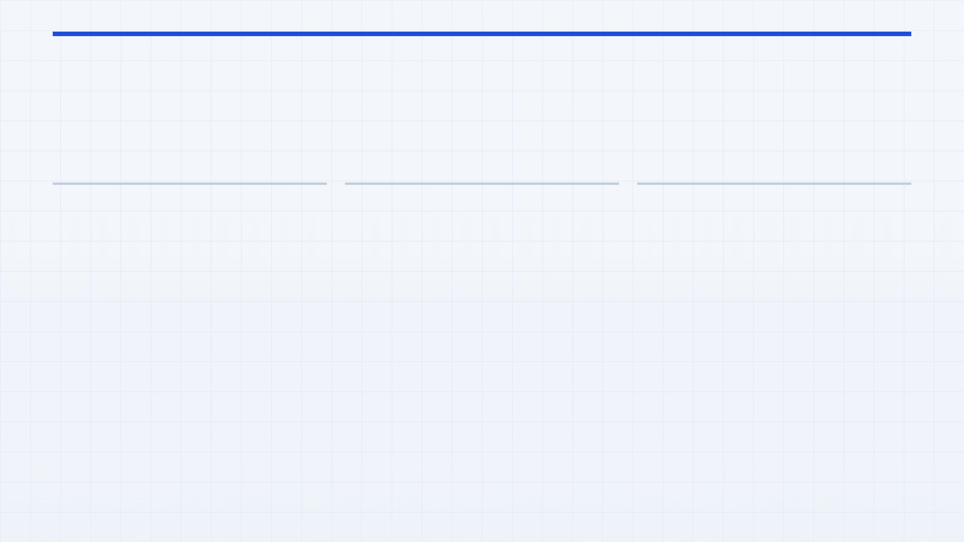
Shipping Determines the Final Memory
STAGE 9 / 9 · INTERNAL OPS
Customers may remember the quote, but they judge reliability at delivery. A late or poorly managed shipment does more than raise freight cost. It damages trust at the final experience moment and weakens the probability of the next order.
CUSTOMER MEMORY
AI INTERVENTION
STRATEGIC RECOMMENDATION
Logistics performance becomes commercial memory
Prediction matters more than passive tracking
Start internally, then turn precision into service
The strongest AI use case is early identification of delay risk, customs issues, and carrier underperformance so teams can intervene before the customer escalates. Better ETA prediction and route ranking turn logistics from reactive status updates into active exception management.
Deploy predictive alerts and intervention workflows for operations teams first. Once the signal quality is trusted, expose proactive customer communications and differentiated reliability service levels built on the same intelligence layer.
For many customers, the shipment is the last visible step in the Protolabs experience. If it arrives late, lacks proactive updates, or creates customs friction, the operational problem becomes a commercial impression.
PROTOLABS TPM-AI
STAGE ANALYSIS WITH SHIPPING AS RETENTION AND INTERVENTION LOGIC

Slide 20

STAGE 9 COMPANION · PREDICTIVE LOGISTICS
Reliability Intelligence Protects Retention
Shipping intelligence matters because logistics failures reduce customer confidence at the last visible moment. The best system predicts risk early, orchestrates intervention fast, and turns reliability into repeat-order advantage.
BUSINESS LOGIC
REQUIRED AI / ML STACK
IMPLEMENTATION + METRICS
Delivery performance is a retention lever
Prediction plus orchestration is the real capability
Start with internal alerts, then expose service value
When a shipment slips, it changes how the customer remembers the entire order. That makes shipping reliability a commercial outcome, not just a logistics KPI.
Core models: ETA prediction, carrier ranking, and delay-risk scoring. Operating layer: orchestration that triggers interventions and proactive communication.
Launch with internal predictive alerts so operations can validate precision and refine intervention playbooks before customers see outputs.
Skills: time-to-event prediction, ranking systems, document classification, and exception management.
OTIF On-time and in-full performance on targeted lanes.
Delay precision Are alerts early and accurate enough to act on?
Support tickets Reactive service load per shipment.
Retention Repeat-order confidence after shipping issues.
PROTOLABS TPM-AI
STAGE 9 COMPANION · PREDICTIVE LOGISTICS, IMPLEMENTATION, AND METRICS

Slide 21
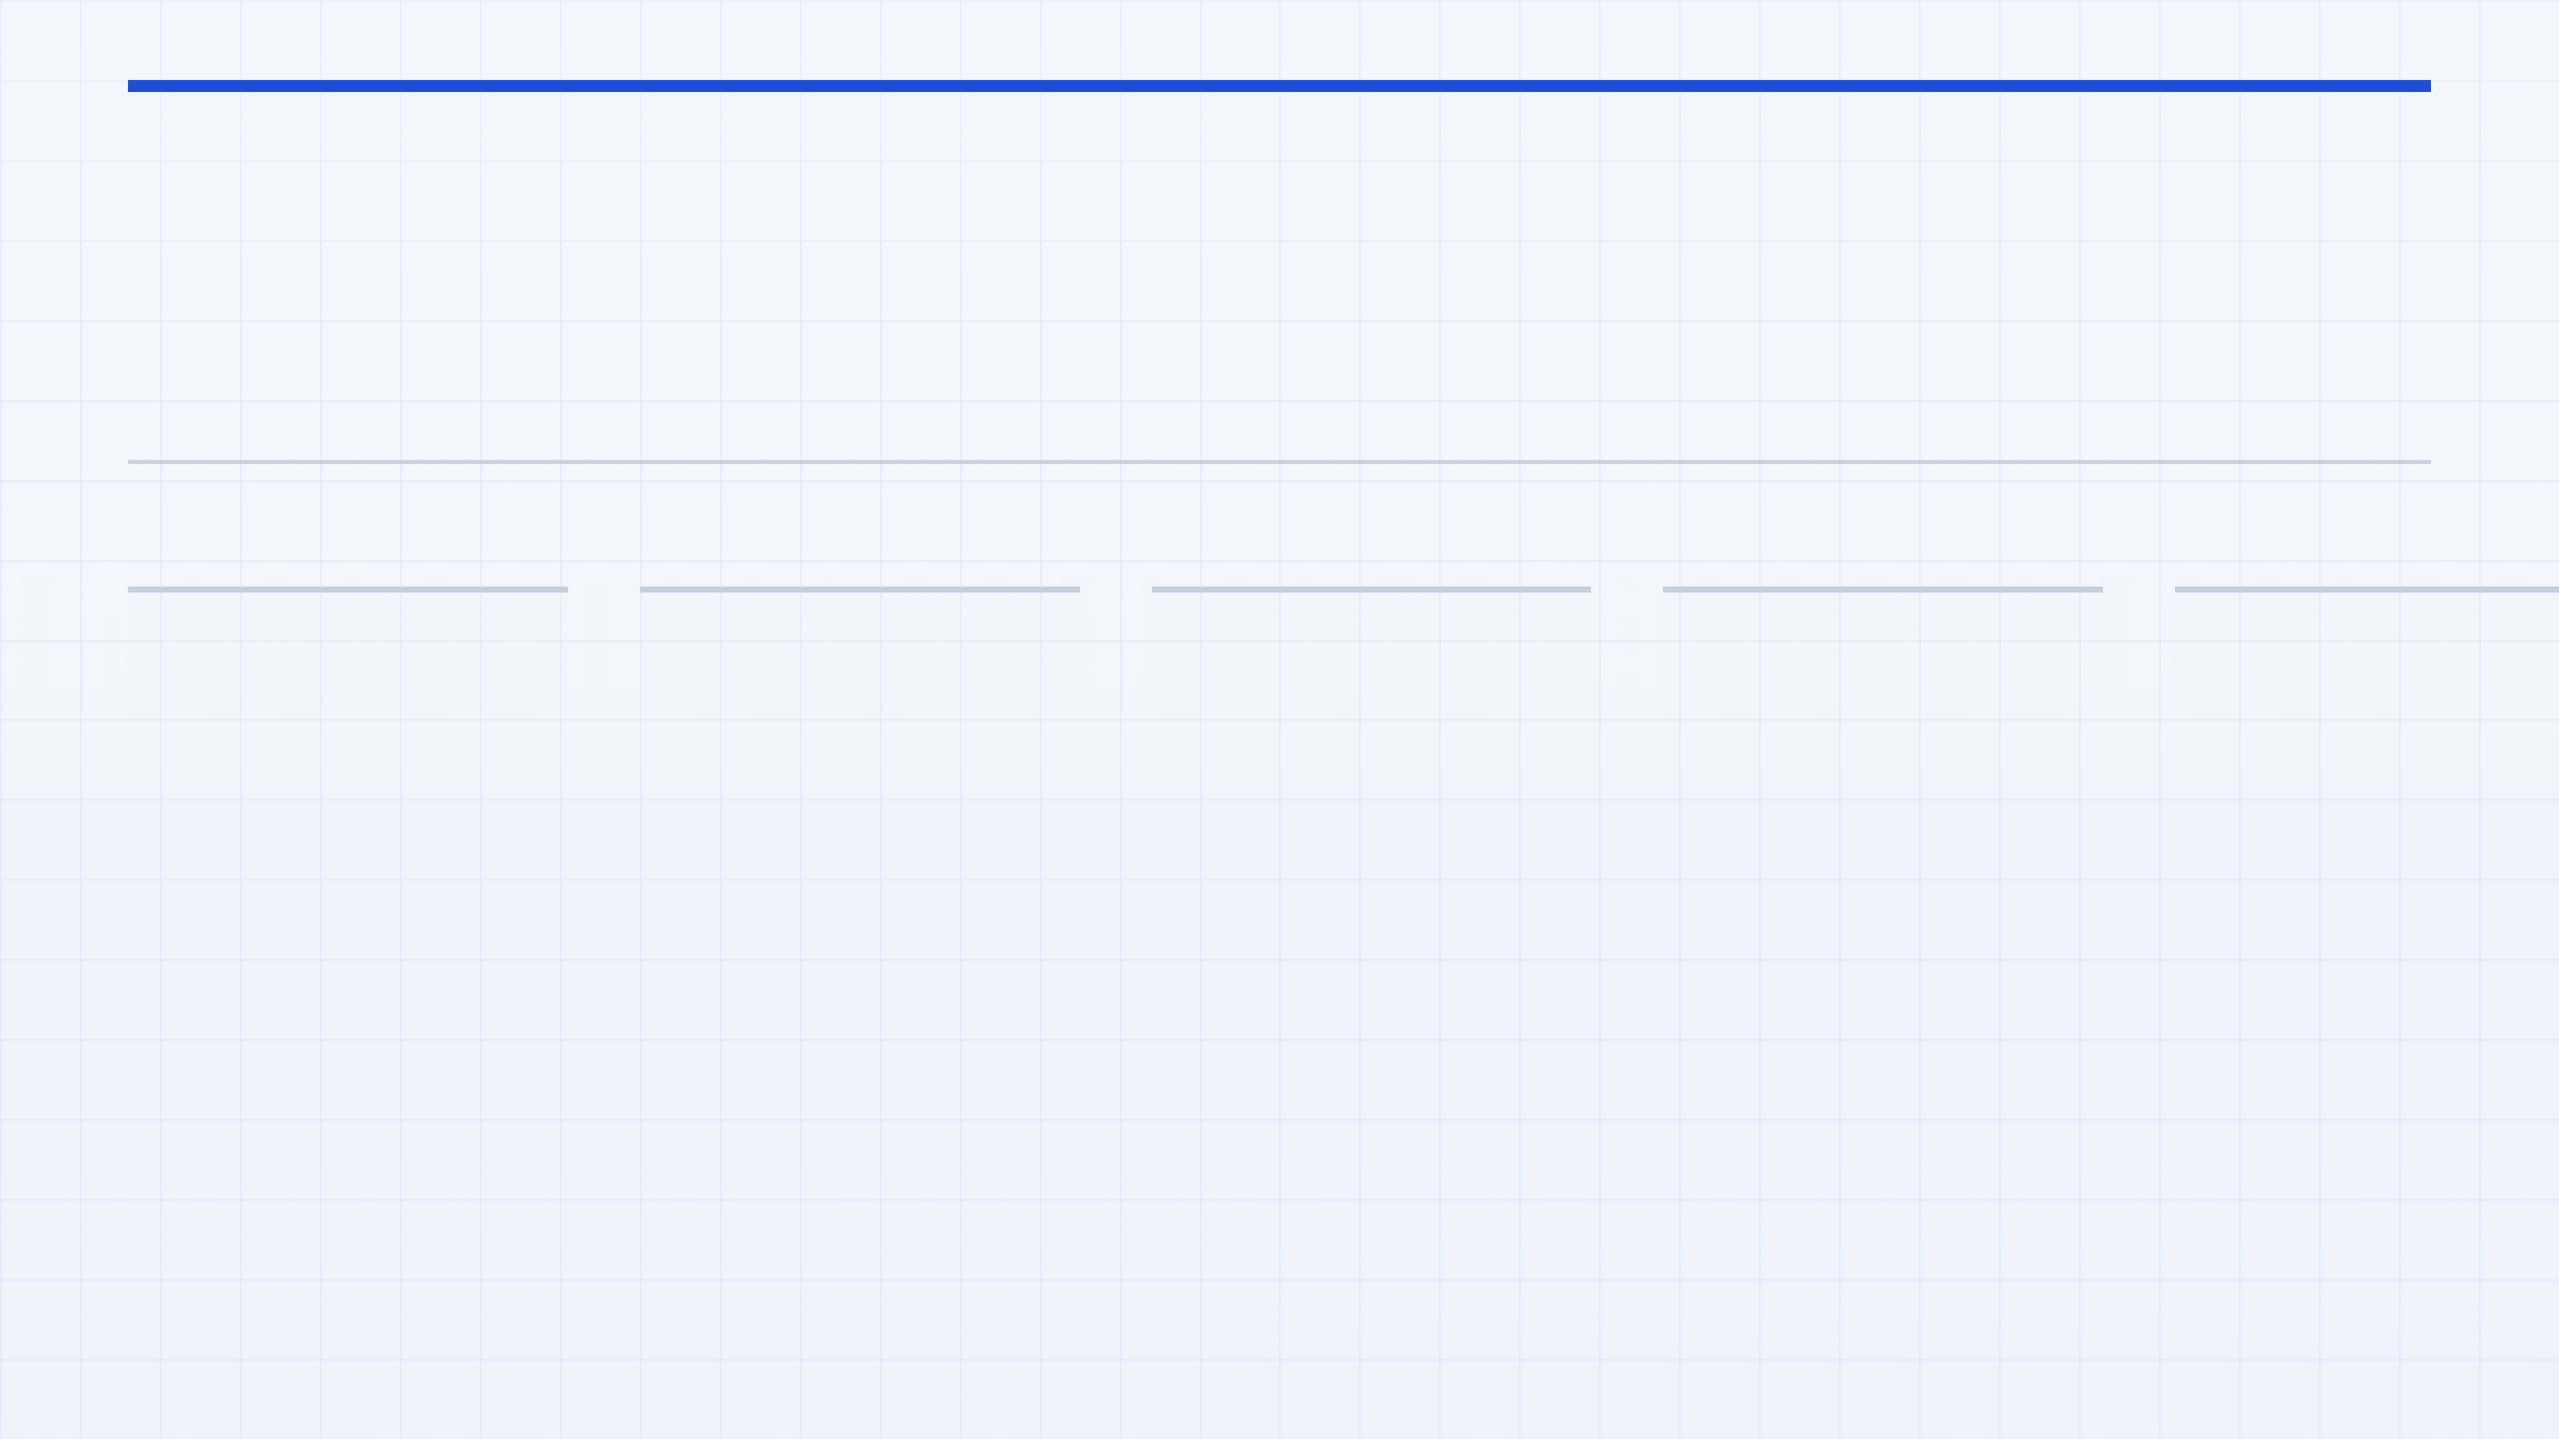
STRATEGIC SEQUENCING
Where I Would Start
With a small team, sequence beats parallelism. The right first wedge is the one that opens revenue, creates structured data, and makes every later AI system easier to ship, trust, and improve.
RECOMMENDED ORDER OF ATTACK
→
→
→
→
1
2
3
4
5
Multimodal Intake
Routing Intelligence
Engineer Copilot
Vision QA
Quote-to-Actual Loop
Ship this early enough to win internal trust. It gives engineers time back quickly, improves response speed, and turns their edits into high-quality feedback data for later systems.
After core workflow data exists, deploy vision where scrap or inspection load is highest. The ROI is clear, the compliance story is strong, and the organization can now absorb a camera-and-model workflow.
Start here because it opens new no-CAD demand and creates the canonical Order Object. Every later system depends on cleaner intake, structured fields, confidence scores, and human corrections.
Once intake is structured, routing can learn from geometry, material, quality, and partner outcomes. This is the strongest moat because the network data compounds and competitors cannot copy it easily.
Close the flywheel by feeding pricing, delivery, routing, and quality outcomes back into decision systems. This is where the roadmap stops being a set of features and becomes a compounding operating model.
PROTOLABS TPM-AI
SEQUENCE FIRST, THEN COMPOUND THE LEARNING LOOP

Slide 22

EXECUTION BLUEPRINT · ENABLING STACK
The Capability Stack Required
To execute this roadmap, Protolabs does not need one model. It needs a coordinated stack that combines decision intelligence, camera systems, data infrastructure, governance, and an operating model that turns human judgment into continuous improvement.
LAYER 1
LAYER 2
LAYER 3
LAYER 4
LAYER 5
Core AI and ML
Computer Vision and Camera Systems
Data Platform
Governance and Monitoring
Operating Model
Multimodal extraction, ranking, forecasting, anomaly detection, recommendation systems, and confidence scoring power intake, routing, pricing, warehousing, and logistics.
The roadmap depends on a canonical Order Object, event logging, telemetry capture, outcome history, and feedback storage across quoting, routing, quality, and delivery.
The stack only works if product, engineering, manufacturing, quality, and operations teams deploy in phases and learn from live use together.
Each stage needs confidence thresholds, override logging, audit trails, drift monitoring, and clear human-in-the-loop controls so performance and trust can scale together.
Vision use cases require industrial cameras, lighting, calibration, guided multi-angle capture, dimensional measurement, and defect detection workflows.
Human expertise must remain visible because engineer and operator corrections are the data flywheel.
Without a shared data model, every AI feature becomes an isolated demo instead of a compounding system.
The key skill is not just training models, but deciding when they should recommend, escalate, or abstain.
Camera engineering matters as much as model quality because unstable capture creates unstable inspection.
This is what makes the roadmap defensible to engineers, customers, and regulators.
Needed skills: staged rollout, workflow design, change management, human-in-the-loop operations, and KPI ownership.
Needed skills: camera selection, lighting design, calibration, image-quality validation, defect labeling, and metrology workflows.
Needed skills: schema design, event pipelines, telemetry ingestion, feature stores, and reliable feedback capture.
Needed skills: model monitoring, threshold tuning, audit design, override analysis, and quality review workflows.
Needed skills: supervised learning, ranking, time-series forecasting, retrieval, and decision-threshold design.
PROTOLABS TPM-AI
CAPABILITY STACK ACROSS AI, VISION, DATA, GOVERNANCE, AND OPERATIONS

Slide 23

CLOSING MESSAGE
AI should make Protolabs faster, easier to buy from, and more trusted to manufacture with.
THE GOAL
FASTER
LOWER FRICTION
TO QUOTE,
ROUTE, AND
DELIVER
EASIER
The best AI bets are not isolated features. They expand the market by lowering intake friction, improve unit economics through better routing, pricing, and operations, and build proprietary learning loops that get stronger with every order, every override, and every production run.
SIMPLER INTAKE,
CLEARER
DECISIONS,
BETTER SERVICE
TRUSTED
HUMAN
That is the strategic standard I would use for every stage in this flow. If an AI investment does not widen the funnel, sharpen the economics, or strengthen trust with engineers, customers, and regulators, it is probably a demo instead of a business advantage.
OVERSIGHT,
AUDITABILITY,
MEASURABLE
OUTCOMES
PROTOLABS TPM-AI
CLOSING PRINCIPLE FOR THE FULL 9-STAGE AI ROADMAP

